Slide 1
STEP-project presentation for ERB- watercore group 14.05.2019 In Kalmar by Torben Jørgensen BEOF
STEP :
Sludge Technological Ecological Progress - increasing the quality and reuse of sewage sludge
Project-partners
Electrical Engineering Faculty, West Pomeranian University of Technology, Szczecin (lead);
Goleniow Water and Sewage Compagny;
Mittskåne Vatten, Höörs Kommun;
Klaipeda University, Ecology Department;
Bornholms Energi og Forsyning (BEOF)

Slide 2
STEP-project focus
Waste Water Treatment plants (WWTP) - small and medium size
Reuse of nutrients in sludge, and reduce pollution in the outflowing water from WWTP
Improve the situation regarding heavy metal pollution in sludge, and incoming water
Transfer projections of the use of sewage sludge to planning agencies and political authorities in the Baltic Sea area
Educate the society and increase public awareness of the challenges that waste water treatment plants are facing
Exchange the good practices of the use of different sludge handling technologies, between different countries and municipalities

Slide 3
STEP-project deliverables
Deliverable 3.1 - Waste water quality and its influence on sludge quality
Deliverable 3.2 - National sludge handling rules comparison
Deliverable 4.1- Plan for sludge treatment of WWTP of different capacity
Deliverable 4.2 - Overview of energy efficiency sludge dewatering
Deliverable 5.1 - Guidelines for efficient composting
Deliverable 5.2 - Technical recommendations for waste air handling and deodorization

Slide 4
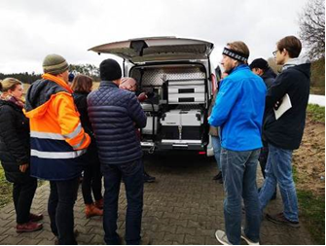
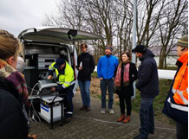
STEP-project work in progress
Deliverable 3.1 - Waste water quality and its influence on sludge quality
STEP project Mobile sampler
The mobile sampler has all the necessary equipment for collecting and temporary storing (in fridges) samples. It is possible to collect 14 samples at once.
Investigation of flow and waste water quality: Sources of heawy metals and excess water

Slide 5
STEP-project work in progress
Deliverable 3.1 - Waste water quality and its influence on sludge quality

Slide 6
STEP-project work in progress
Deliverable 3.2 - National sludge handling rules comparison
preliminary conclusion and recommendations
Accumulated scientific evidence points to, that there are no adverse effects of using sludge from WWTP’s in agriculture
The barriers to the use of sludge from WWTP’s as fertilizer in agriculture is mainly psykological
Extremely strict National Limit Values can be a barriers (eg. Copper in Sweden)
Use of heavy metals and chemicals in different products should be further restricted (eg. Cadmium in paints)

Slide 7
STEP-project – common goal
Our common view on sludge from WWTPs, based on an ecological approach:
As much as possible of the nutrients in the treated waste water should be collected in the sludge / as little as possible of nutrients, organic matter, and chemical in the waste water should pass onto the recipients.
Sludge is a valuable biomass and, if possible, should be used as fertilizer in agriculture, so the valuable nutrients are recycled, and the carbon in the sludge is build into the soil, instead of quickly released as CO2.
Sludge, if possible, should be digested to produce biogas / energy, thus replacing fossil fuels

